Slide 1
Main Figures

Slide 2
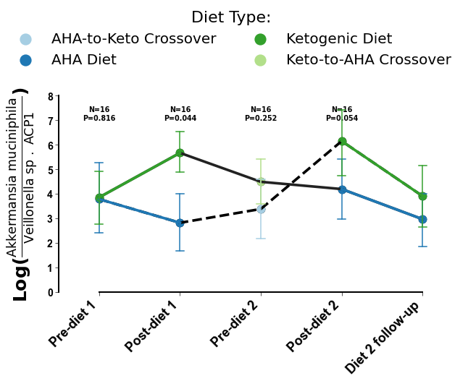
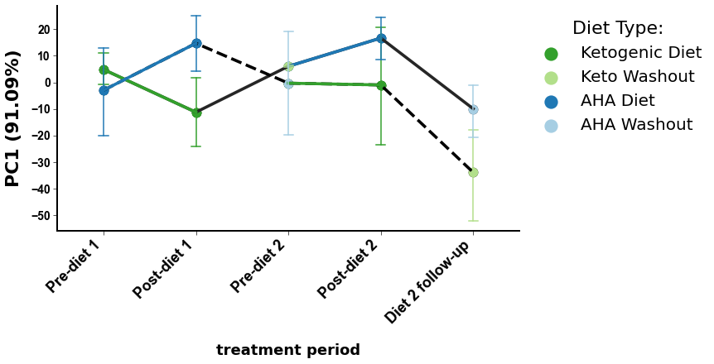
a
b
Notes:
Figure 1. Cross-sectional beta-diversity analysis demonstrates subject specific microbiome and metabolome. Repeated measures aware beta-diversity observe diet specific cross-over trends.

Slide 3
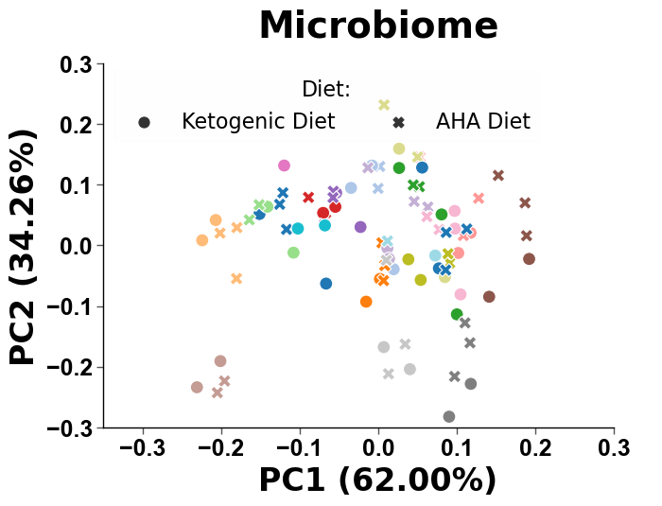
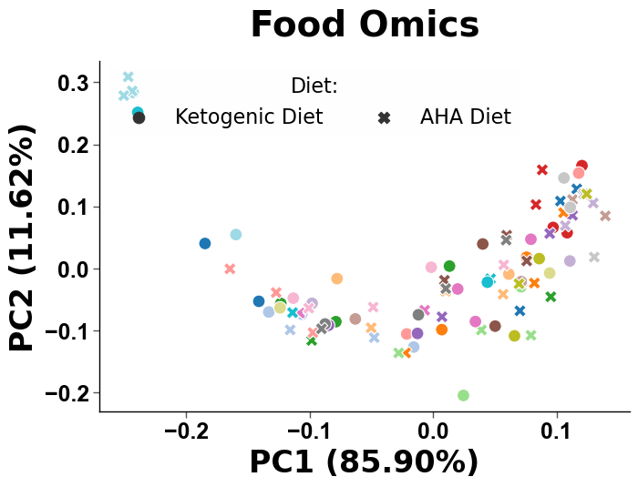
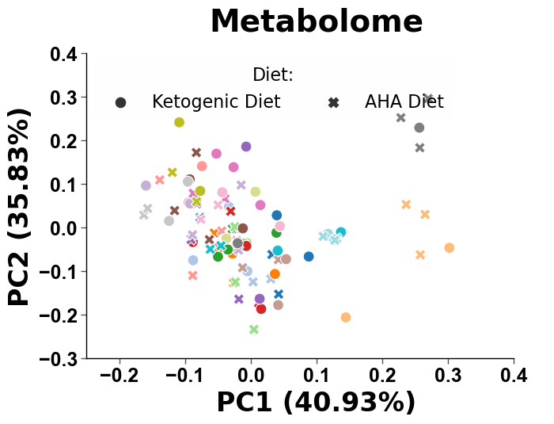
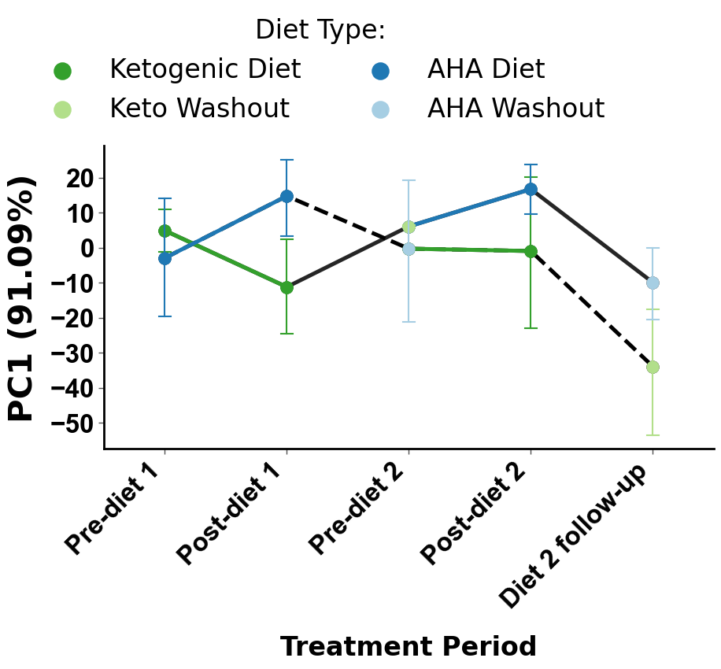
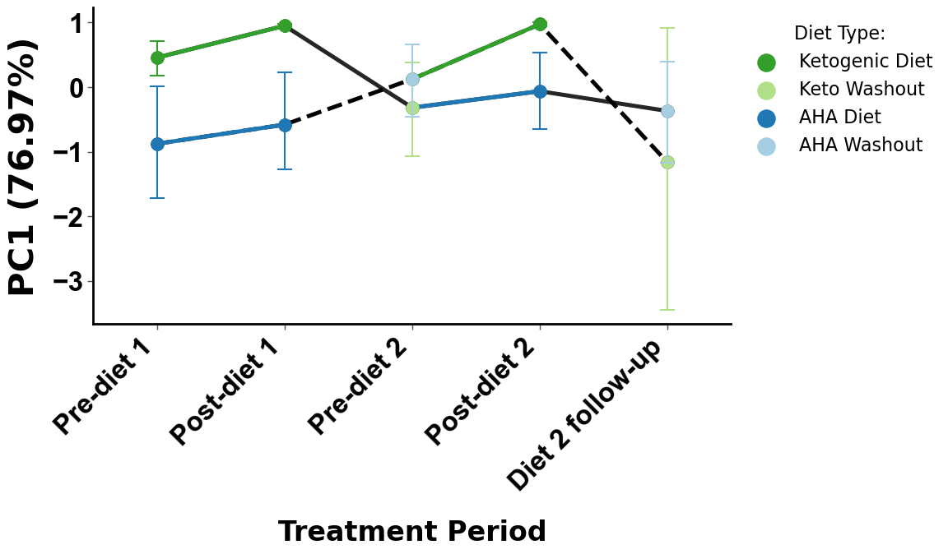
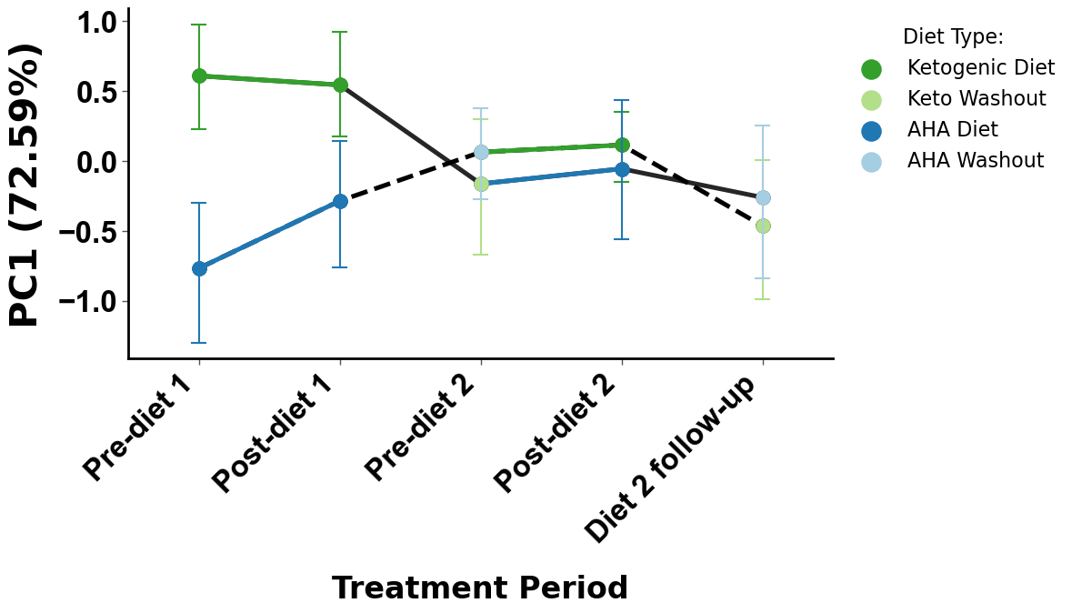
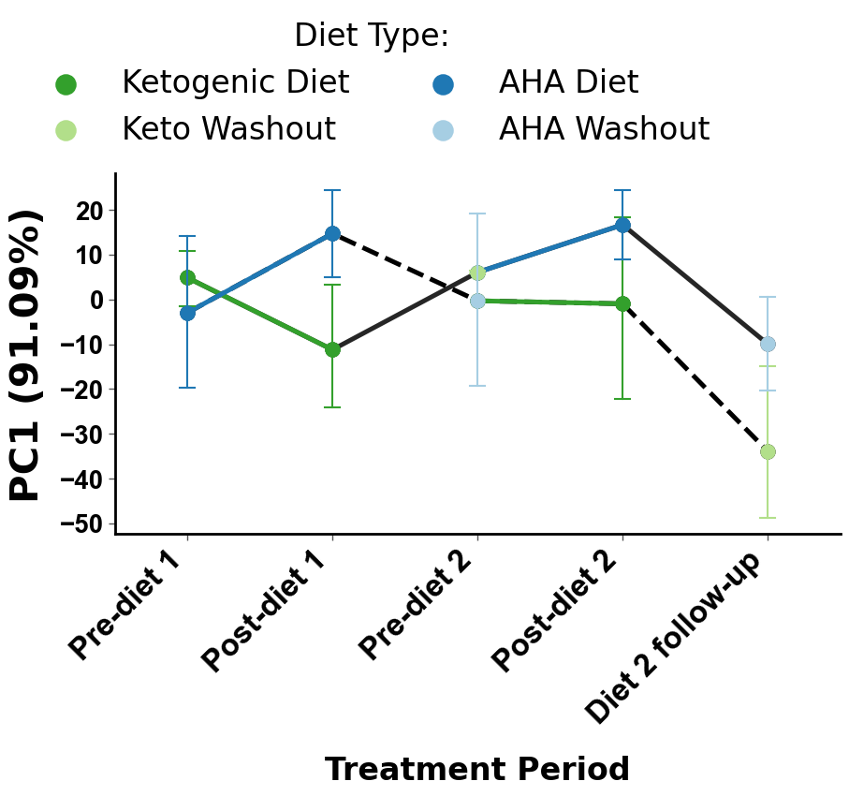
a
b
Notes:
Figure 1. Cross-sectional beta-diversity analysis demonstrates subject specific microbiome and metabolome. Repeated measures aware beta-diversity observe diet specific cross-over trends.

Slide 4
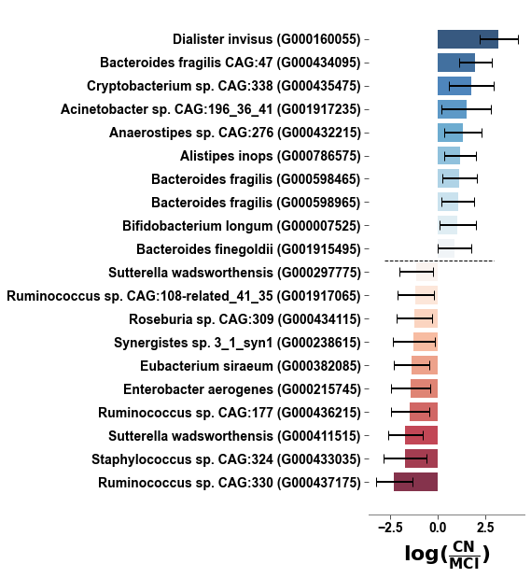
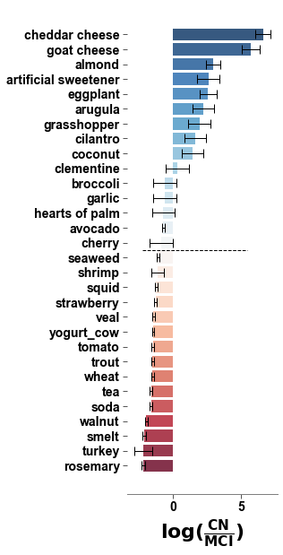
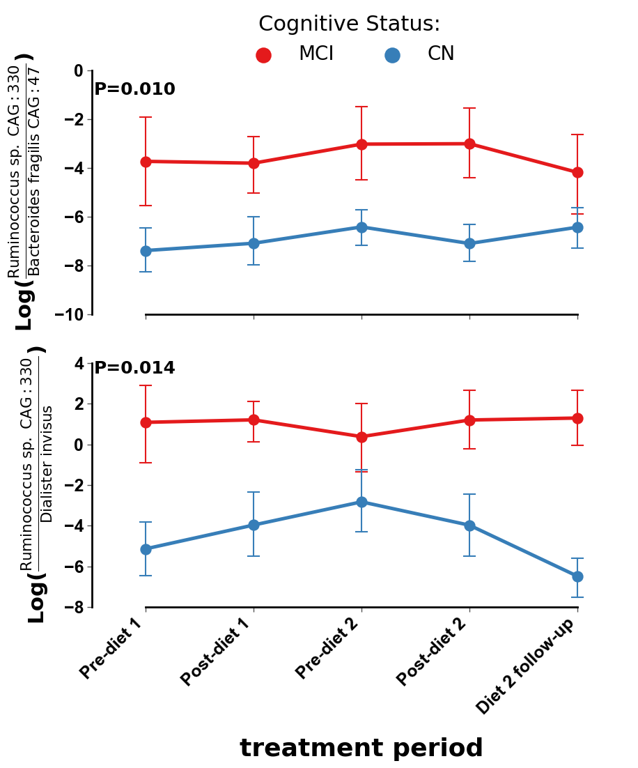
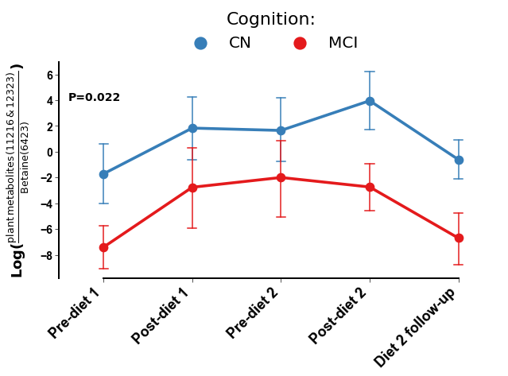
Microbiome
Food Omics
Metabolomics
a
b
c
d
e
Notes:
Figure 2. Differential abundance model controlling for repeated measures and subject specificity identify cognition specific markers that are not impacted by diet.

Slide 5
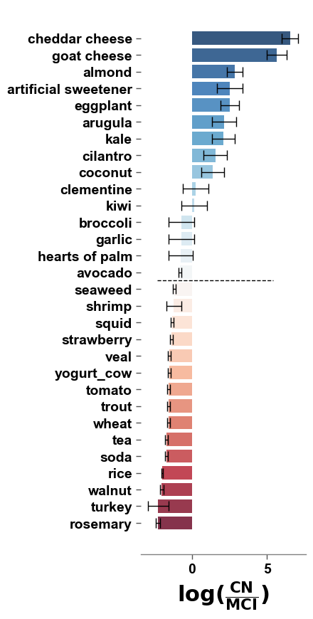
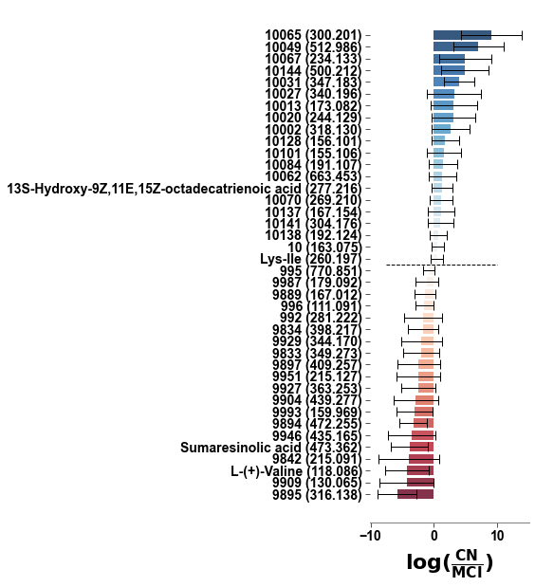
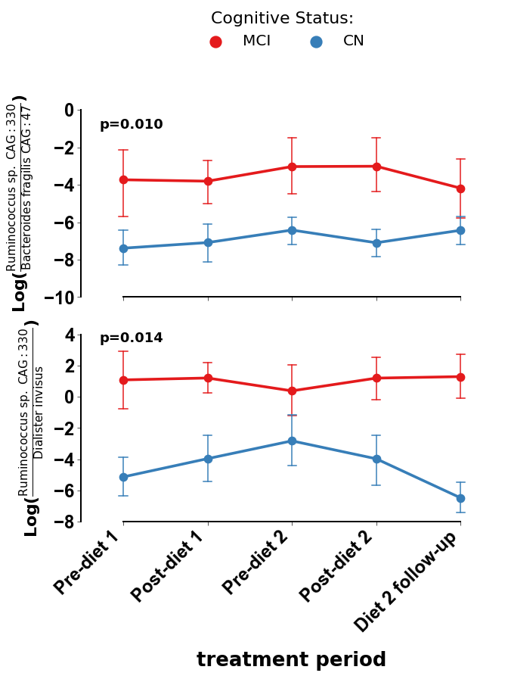
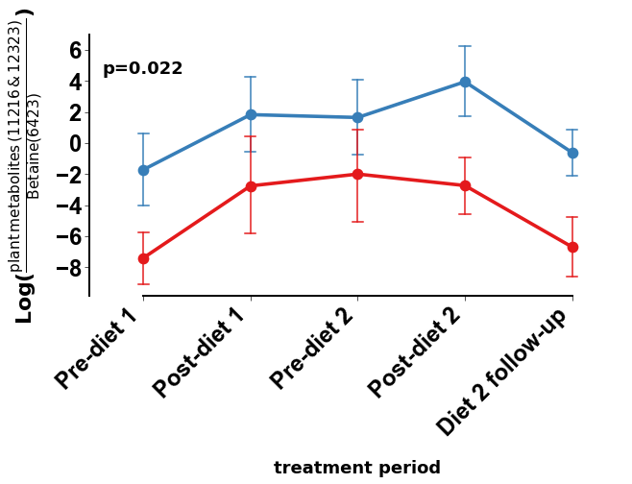
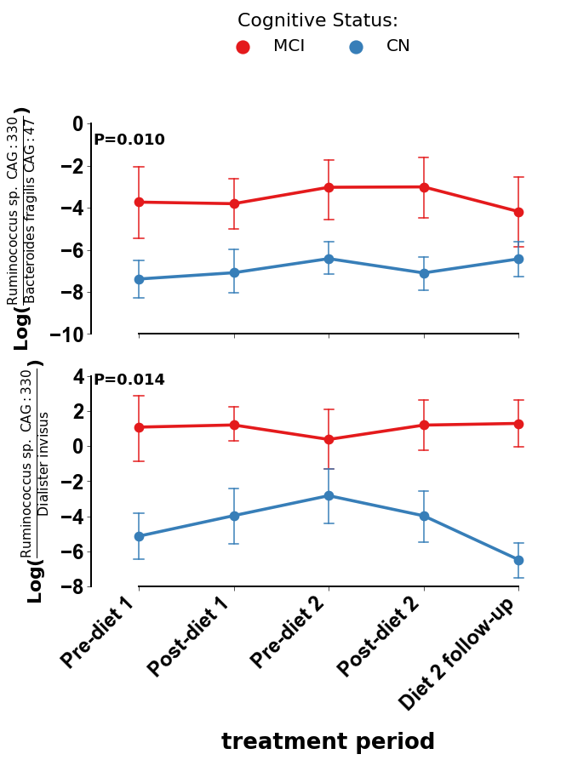
a
Microbiome
b
Food Omics
c
Metabolomics
d
e
Notes:
Figure 2. Differential abundance model controlling for repeated measures and subject specificity identify cognition specific markers that are not impacted by diet.

Slide 6
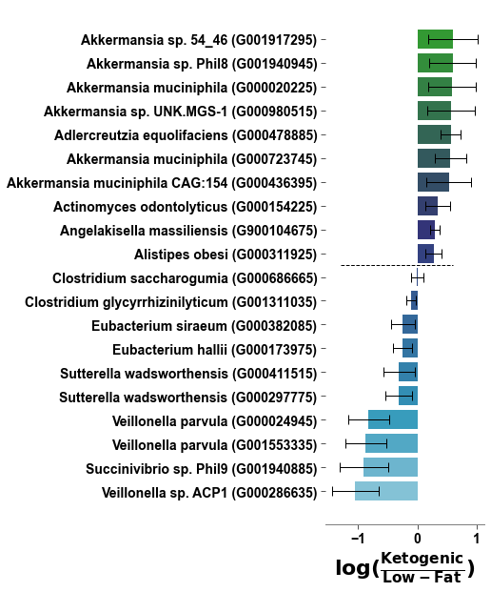
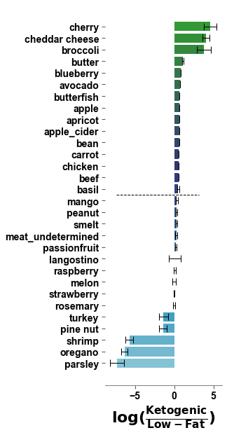
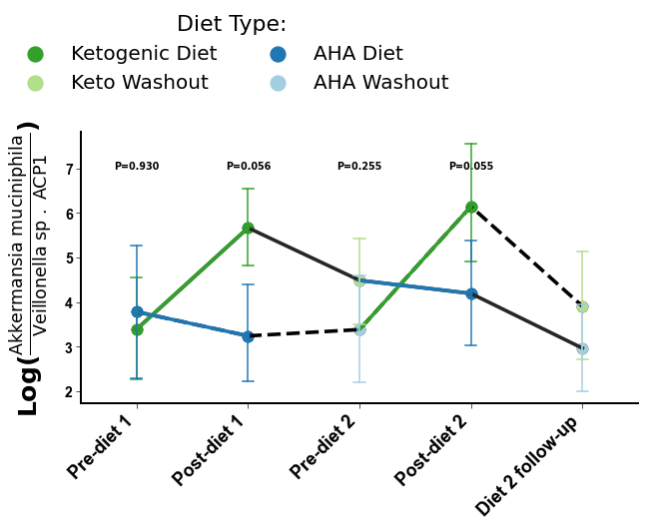
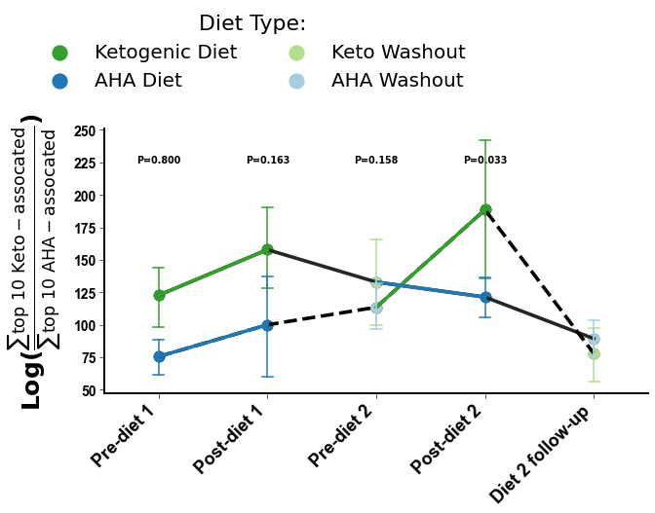
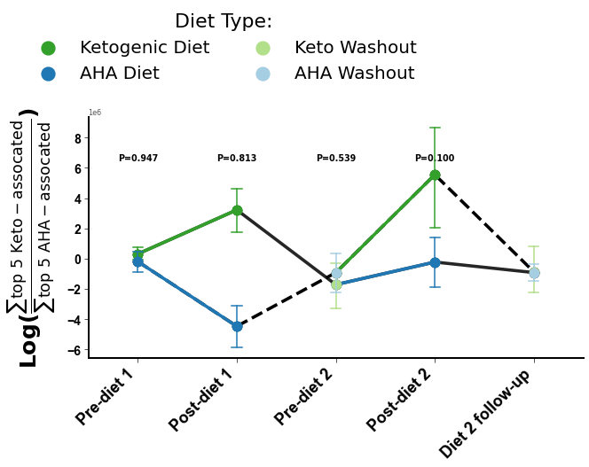
Microbiome
Food Omics
Metabolomics
a
b
c
d
e
f
Notes:
Figure 3. Differential abundance model controlling for repeated measures and subject specificity identify diet specific markers that follow cross-over design.

Slide 7
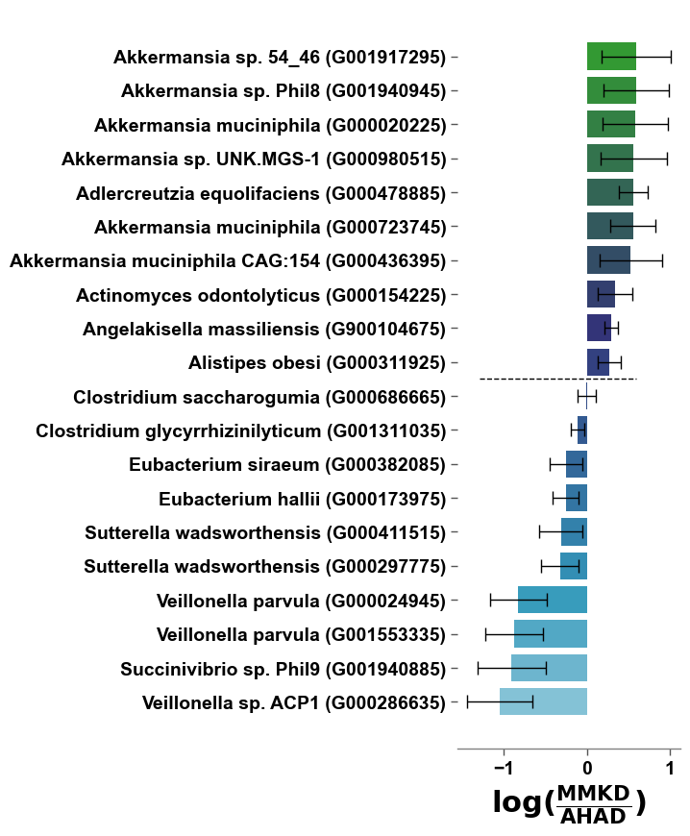
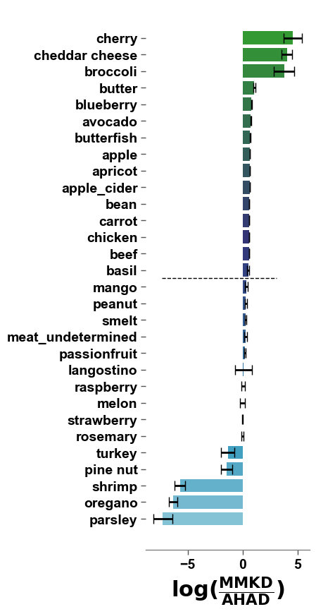
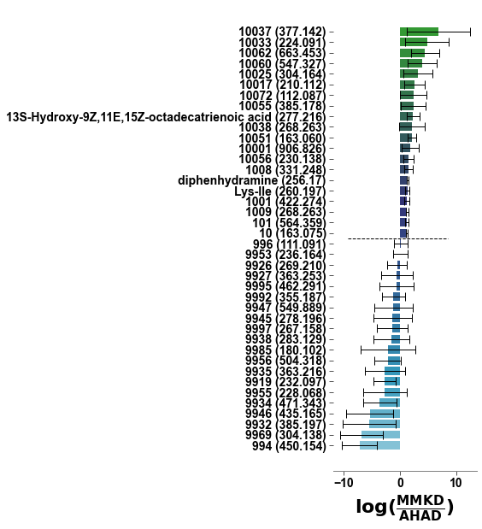
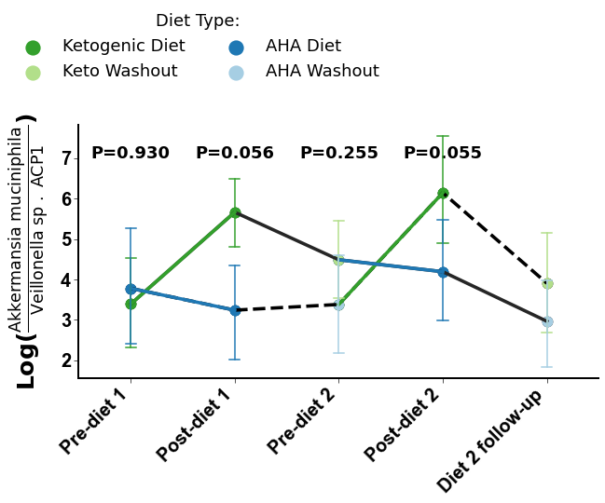
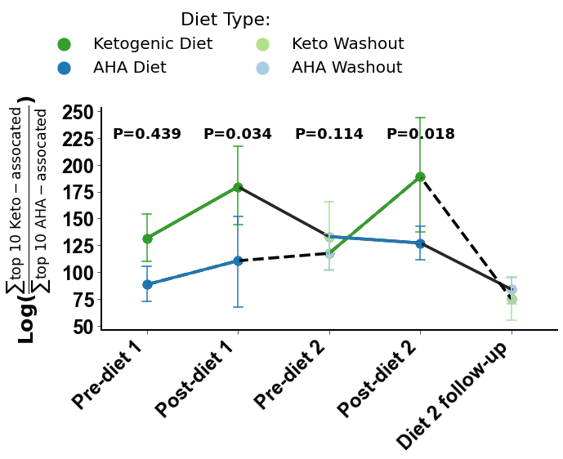
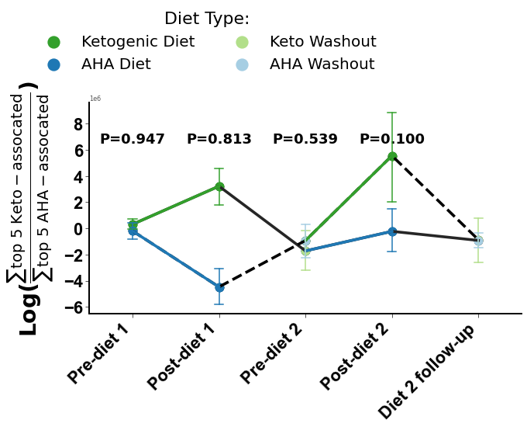
a
Microbiome
b
Food Omics
c
Metabolomics
d
e
f
Notes:
Figure 3. Differential abundance model controlling for repeated measures and subject specificity identify diet specific markers that follow cross-over design.

Slide 8
Microbiome
Metabolomics
a
c
b
d
Notes:
Figure 4. Differentially abundant microbes, food groups, and metabolites associated with both low-fat diet and mild cognitive impairment or ketogenic diet and normal cognition also co-occur together differentially by associated groups.

Slide 9
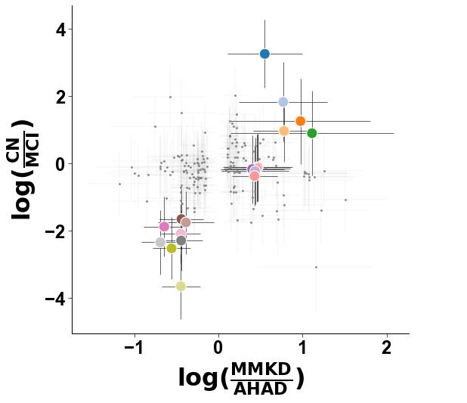
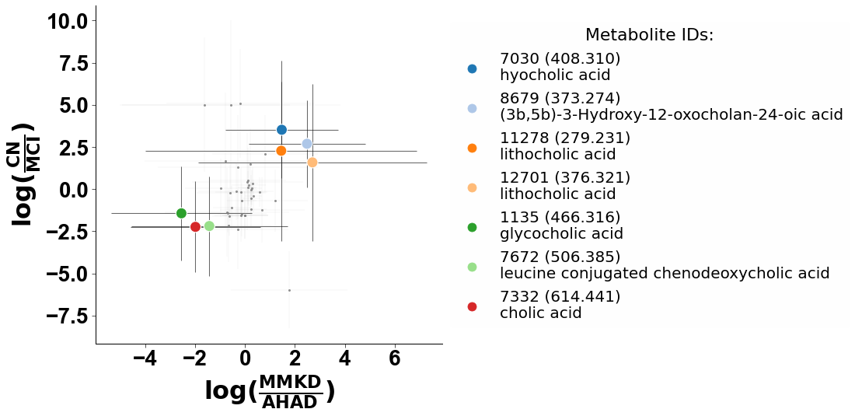
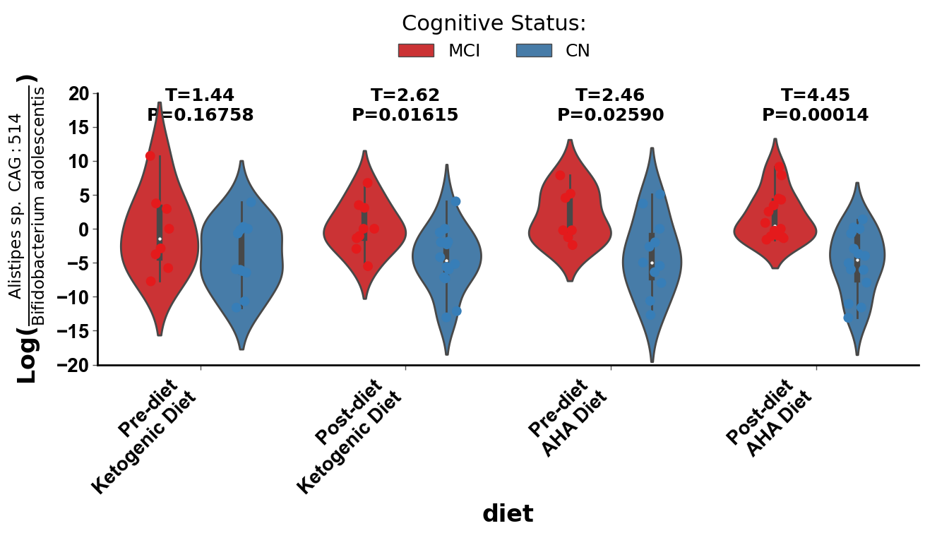
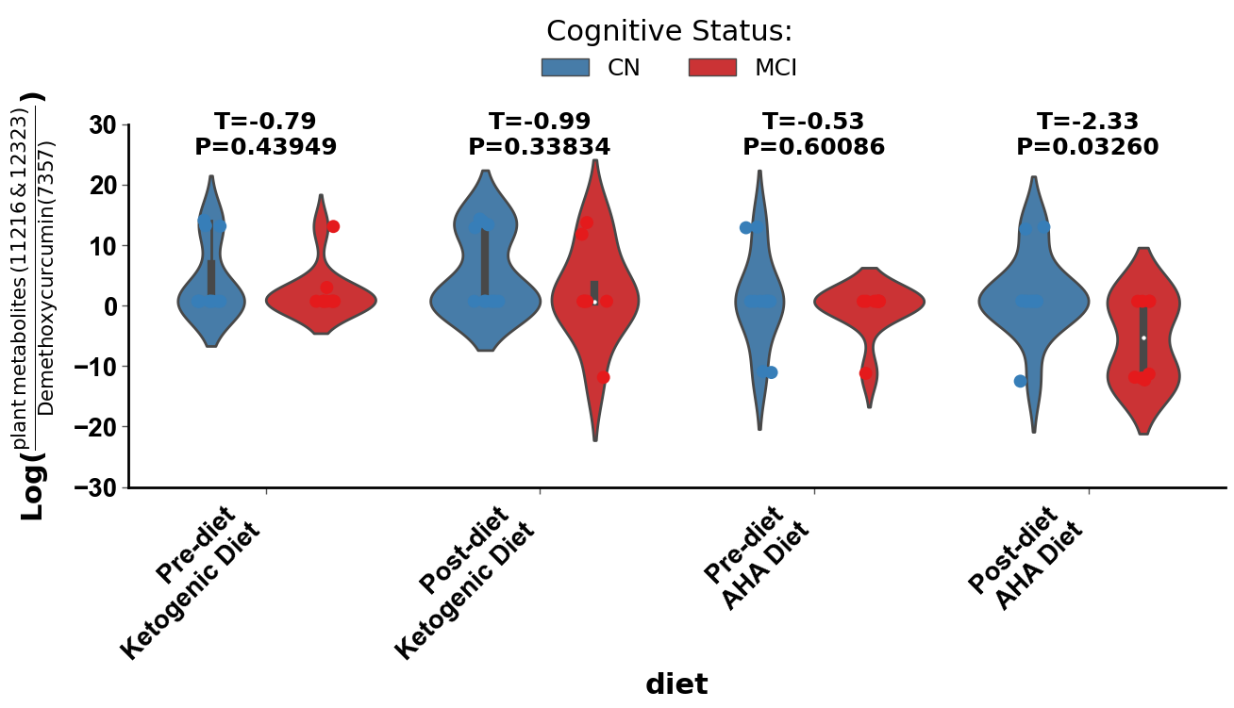
Microbiome
Metabolomics
a
c
b
d
Notes:
Figure 4. Differentially abundant microbes, food groups, and metabolites associated with both low-fat diet and mild cognitive impairment or ketogenic diet and normal cognition also co-occur together differentially by associated groups.

Slide 10
a
b
c
Notes:
Figure 5.

Slide 11
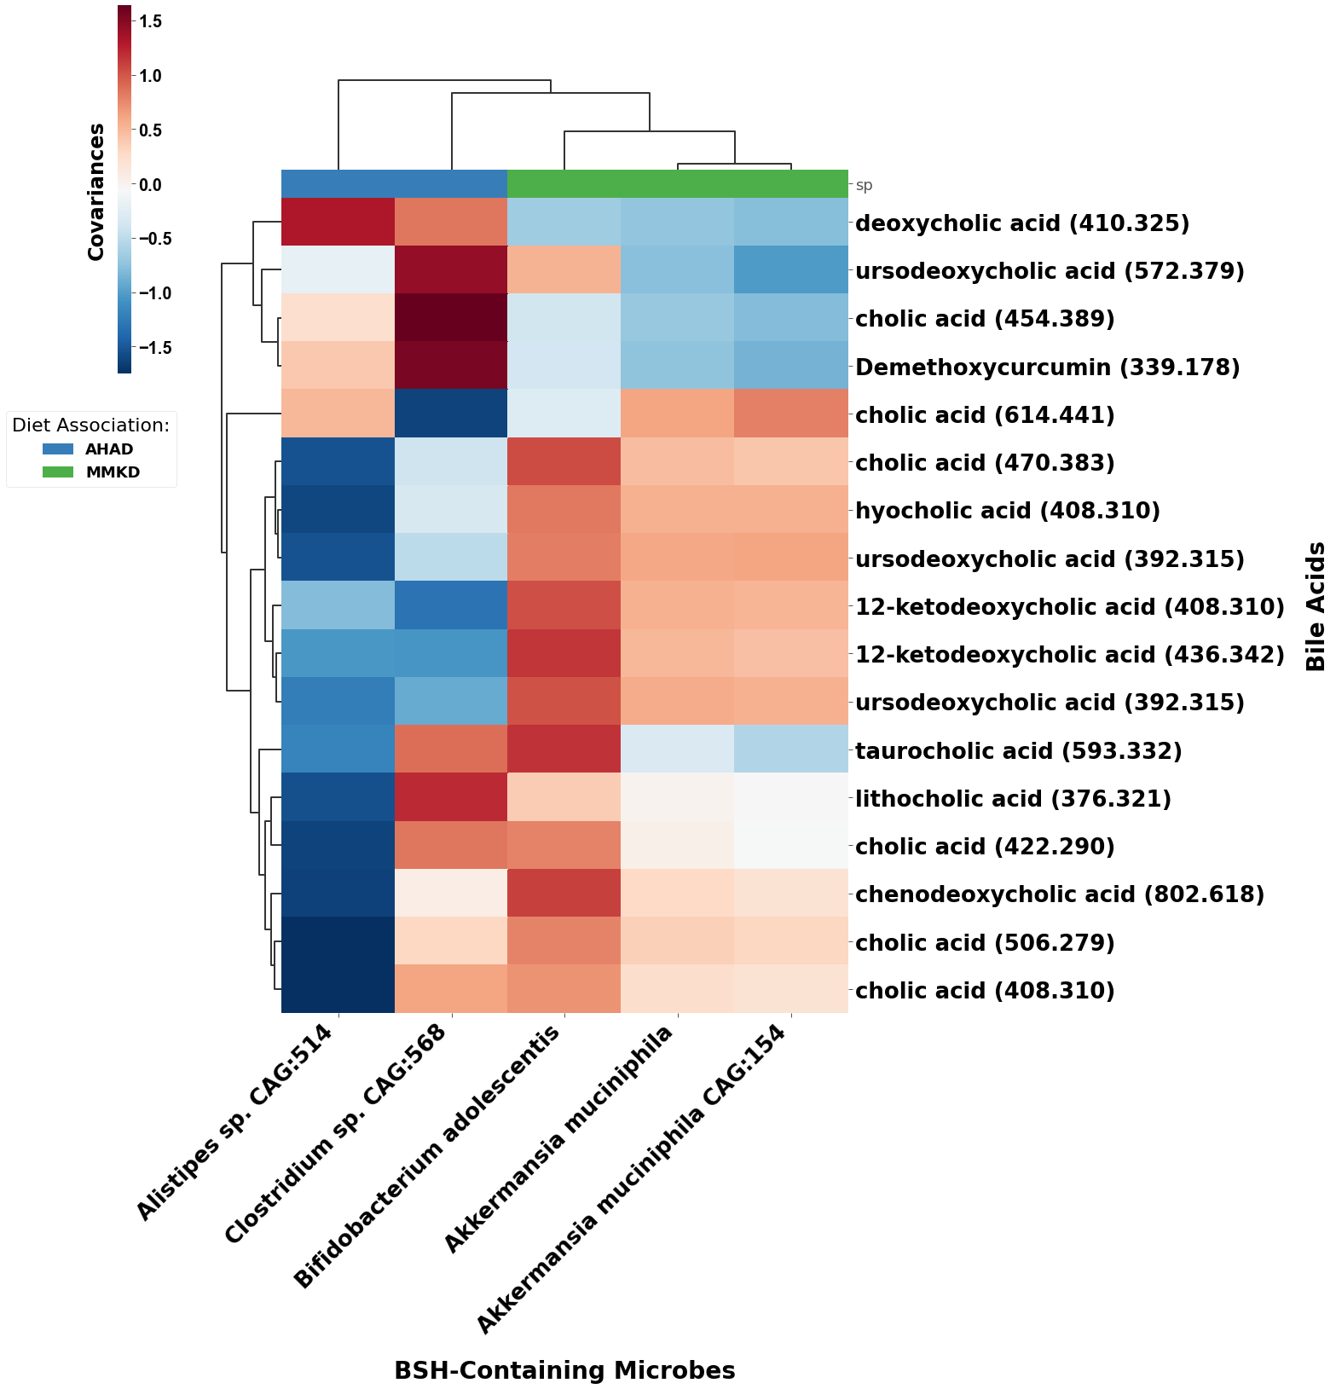
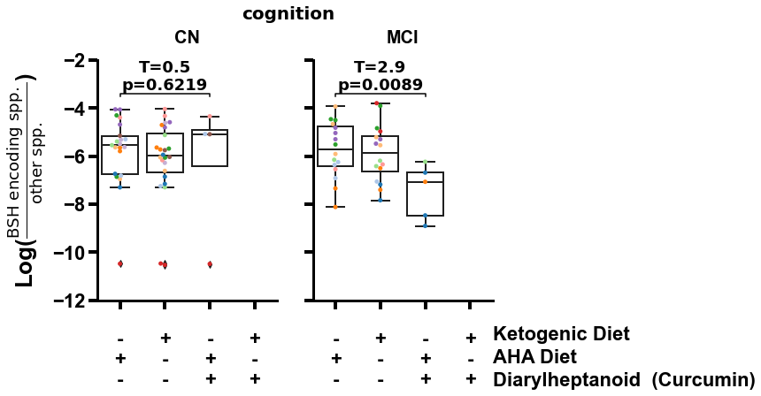
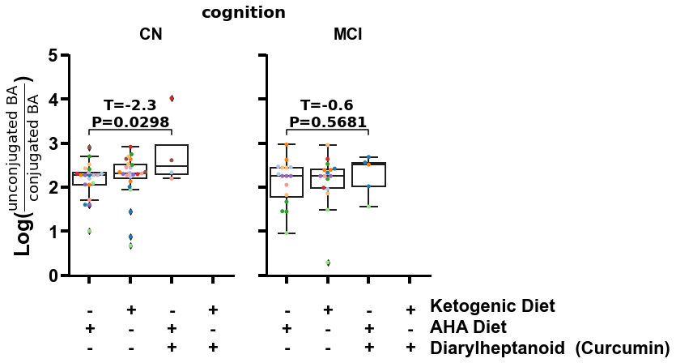
a
b
c
Notes:
Figure 5.

Slide 12
Supplemental Figures

Slide 13
A
Microbiome
C
Food Omics
E
Metabolomics
B
D
F
Notes:
Figure 4. Differentially abundant microbes, food groups, and metabolites associated with both low-fat diet and mild cognitive impairment or ketogenic diet and normal cognition also co-occur together differentially by associated groups.

Slide 14
Notes:
Figure S1. TODO

